Slide 1
Data Wrangling and Data Analysis
Data Visualization
Daniel L. Oberski & Erik-Jan van Kesteren
Department of Methodology & Statistics
Utrecht University

Slide 2
This week
Data visualization principles
The grammar of graphics
Exploratory data analysis (EDA)
Goal of the week: know how to create and improve data visualizations, and know how to use them for exploration

Slide 3

Reading materials for this week
Chapters from R for Data Science (R4DS), open access book at:
https://r4ds.had.co.nz
Today: ch 3 visualization
Tomorrow: chh 3, 5, 7

Slide 4
Assignments this week
Monday: Tidy data visualization with dplyr and ggplot
Tuesday: Exploratory data analysis
Thursday: either (a) resit for the test, or (b) assignment on advanced data visualization

Slide 5
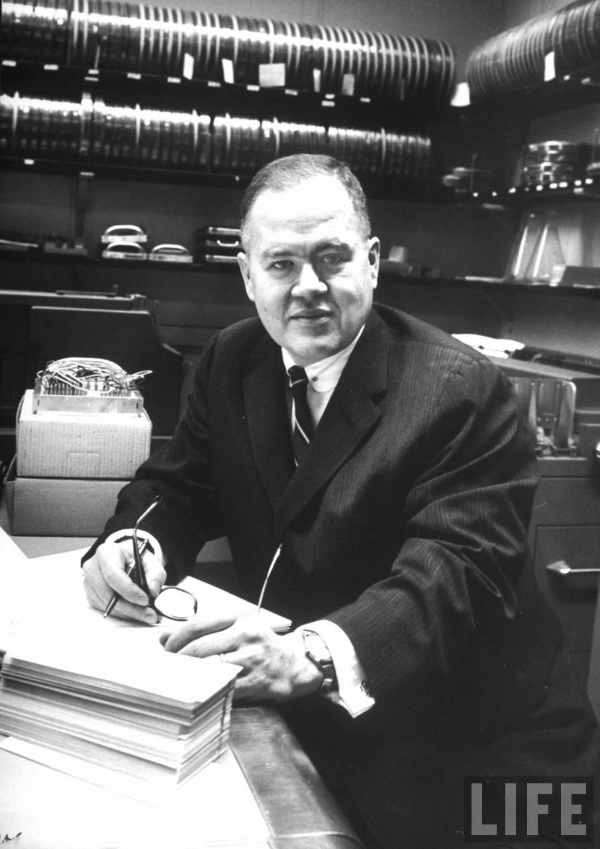
John Tukey (1915 – 2000)
Data Scientist patient zero
Inventor of:
The boxplot
The term “exploratory data analysis”
The Fast Fourier Transform
“Tukey’s test”
The word “bit”
So, so much more (Wikipedia)

Slide 6
Today: visualization principles

Slide 7
Some data visualization principles

Slide 8
Data visualization
For exploration, data analysis ←
For communication
For entertainment

Slide 9
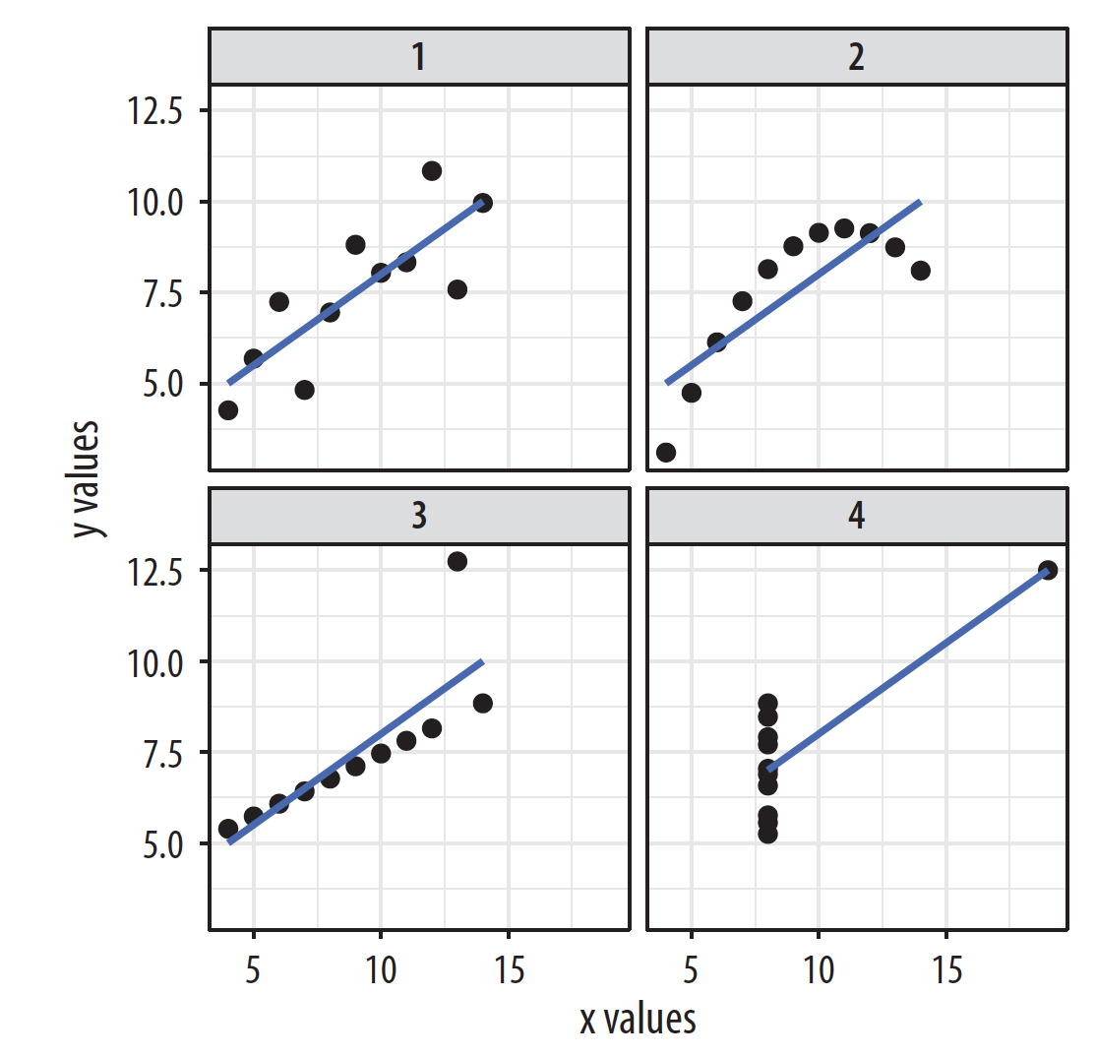
Anscombe’s quartet
Source: Healy (2019)

Slide 10
Source: Healy (2019)

Slide 11
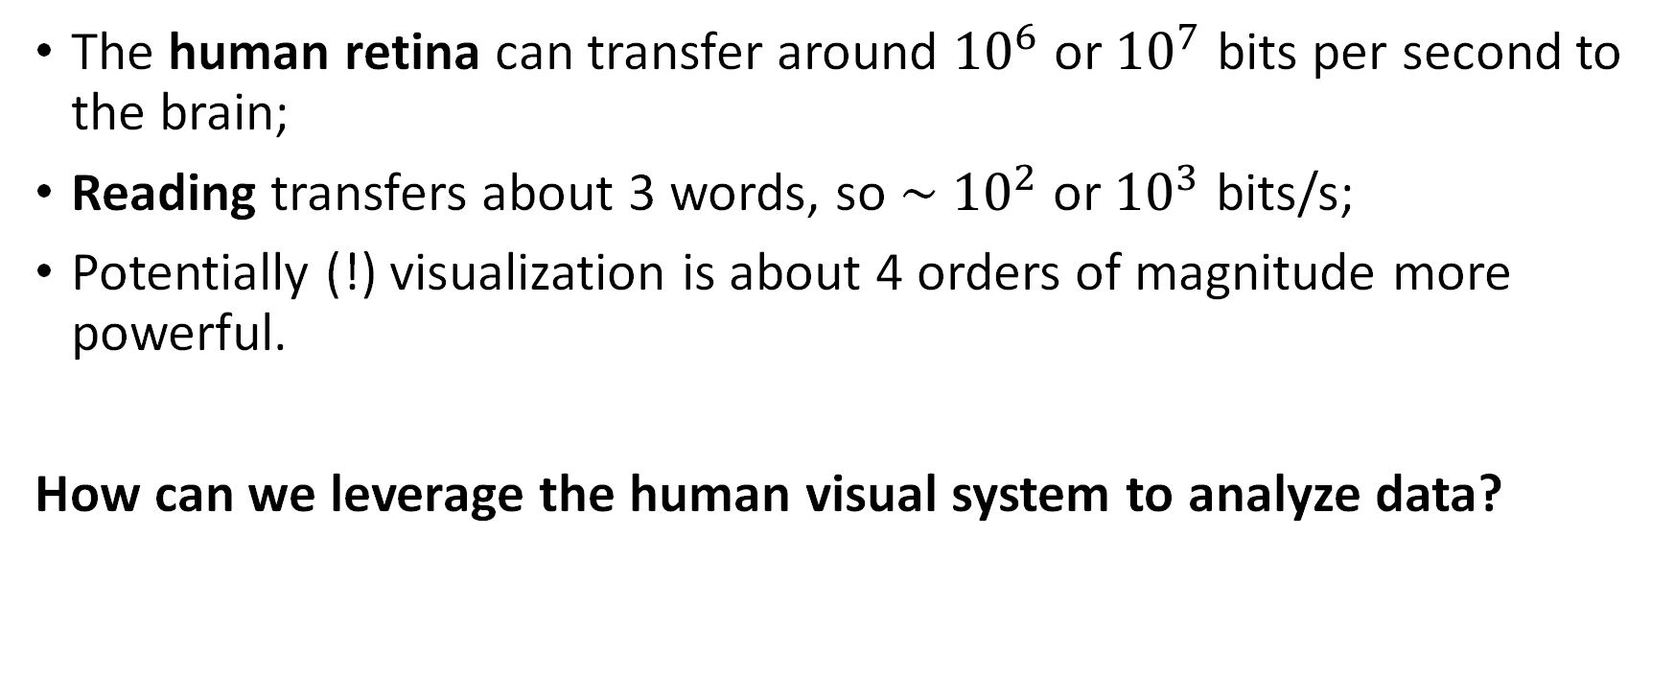
Graphics for data analysis
The human retina can transfer around ${10}^{6}$ or ${10}^{7}$ bits per second to the brain;
Reading transfers about 3 words, so ∼ ${10}^{2}$ or ${10}^{3}$ bits/s;
Potentially (!) visualization is about 4 orders of magnitude more powerful.
How can we leverage the human visual system to analyze data?

Slide 12
Plotting the right thing
Most common problems:
(Accidentally) misrepresenting what is being plotted
Omitting baselines

Slide 13
Source: Healy (2019)

Slide 14
Source: Healy (2019)

Slide 15
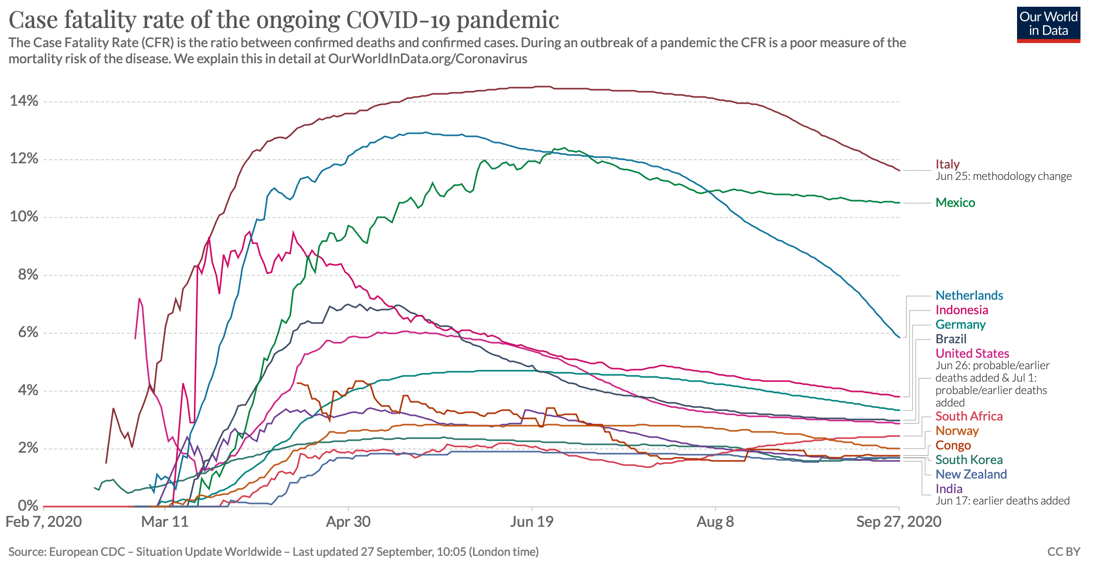

Slide 16
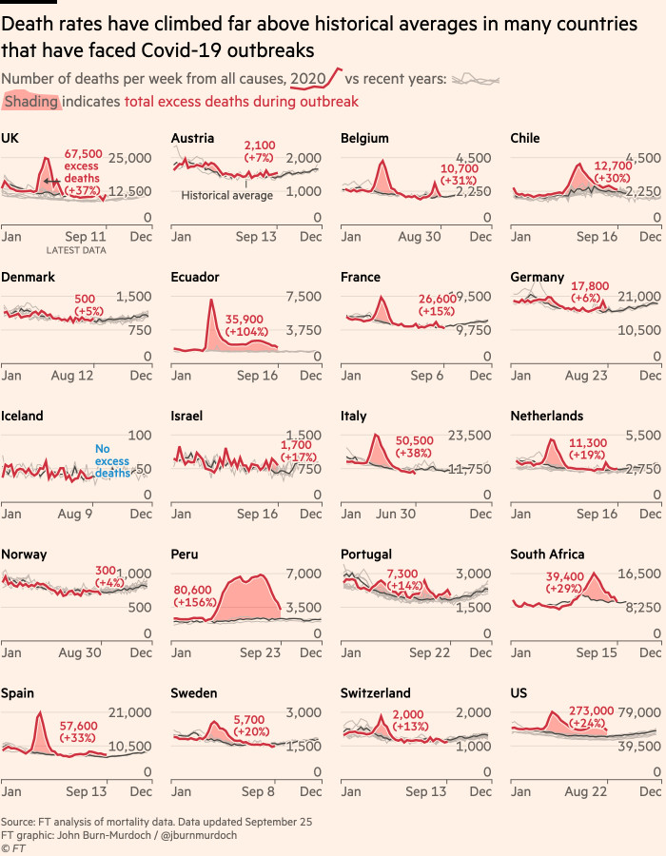
Good example (FT)
https://www.ft.com/content/a2901ce8-5eb7-4633-b89c-cbdf5b386938

Slide 17
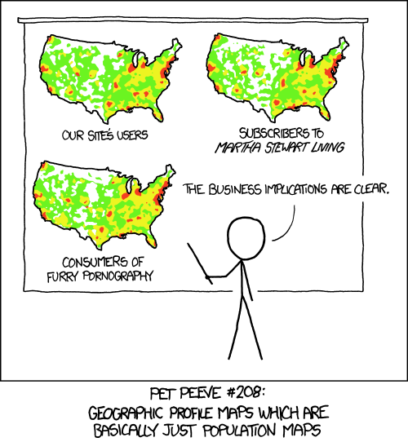

Slide 18
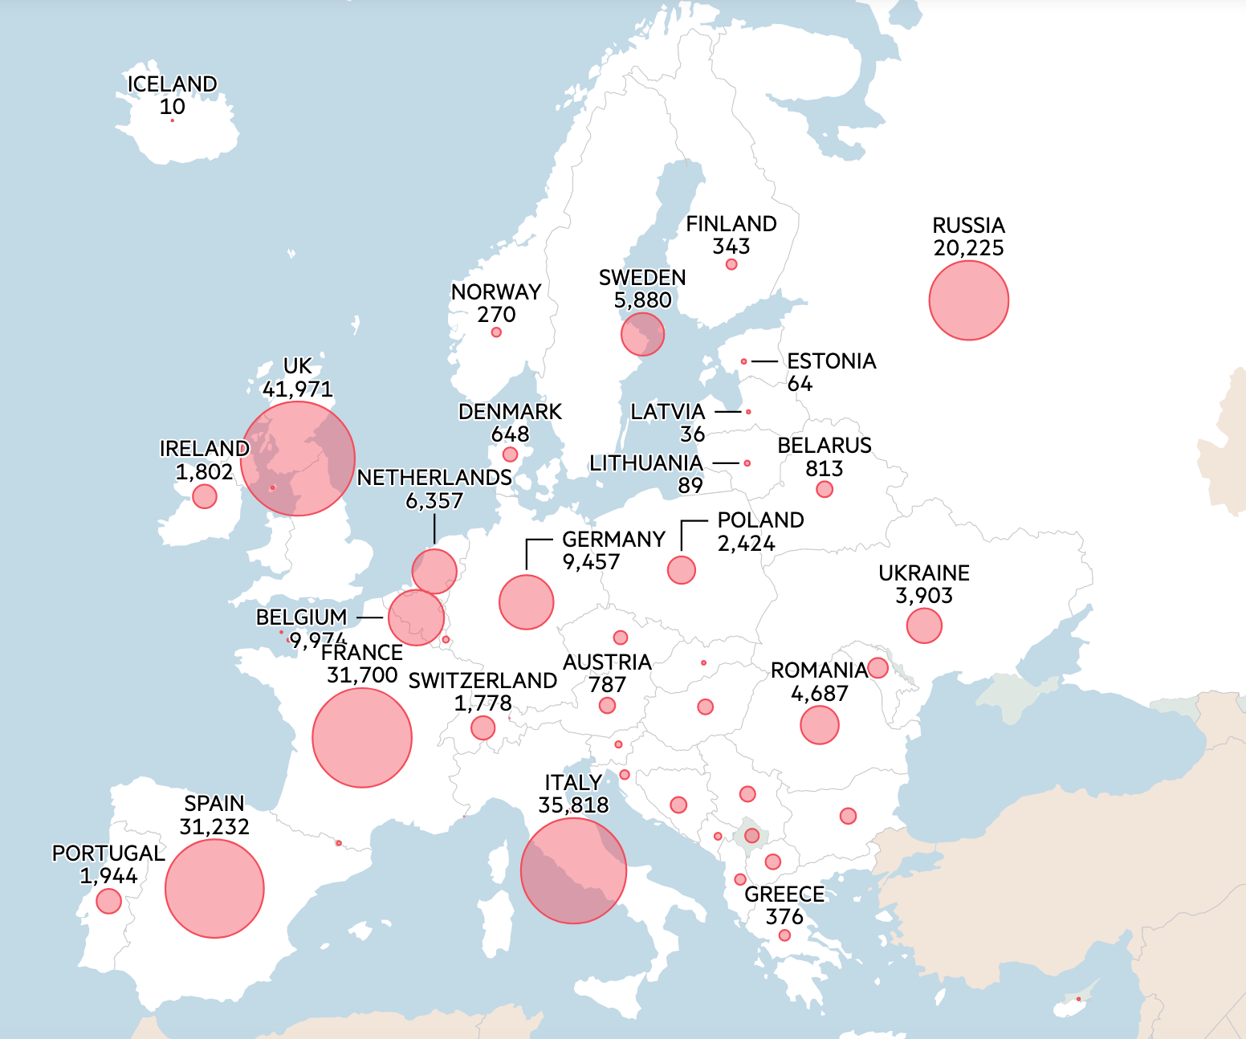
Missing a baseline…?
https://www.ft.com/content/a2901ce8-5eb7-4633-b89c-cbdf5b386938

Slide 19
Making pictures that help analyze data
We’d like to make, not just any kind of picture or graph, but one that transfers some part of the data to our brain
How do we make sure that the graphs we make transfer:
The right part of the data, and;
As much of it as possible?
This is where the “grammar of graphics” comes in.
Goal is to specify how data map to picture, so the correct type and largest amount possible is transferred

Slide 20
Grammar of graphics (Wickham version)
http://r4ds.had.co.nz/visualize.html
Map raw data to following elements:
Aesthetics (position, shape, color, ...)
Hetric objects (points, lines, bars, ...)
Scales (continuous, discrete, ...)
Facets (small multiples)
Additionally, can apply:
Statistical transformation (identity, binning, median, ...)
Coordinate system (Cartesian, polar, parallel, ...

Slide 21
Grammar of graphics (Wickham version)
In R, grammar of graphics is implemented in ggplot, a function in the ggplot2 package.

Slide 22
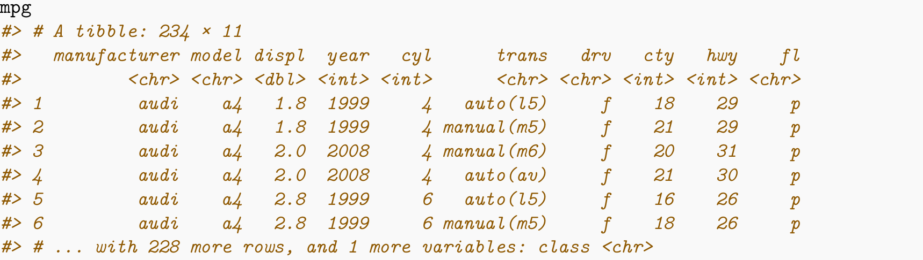
Example data set: cars

Slide 23
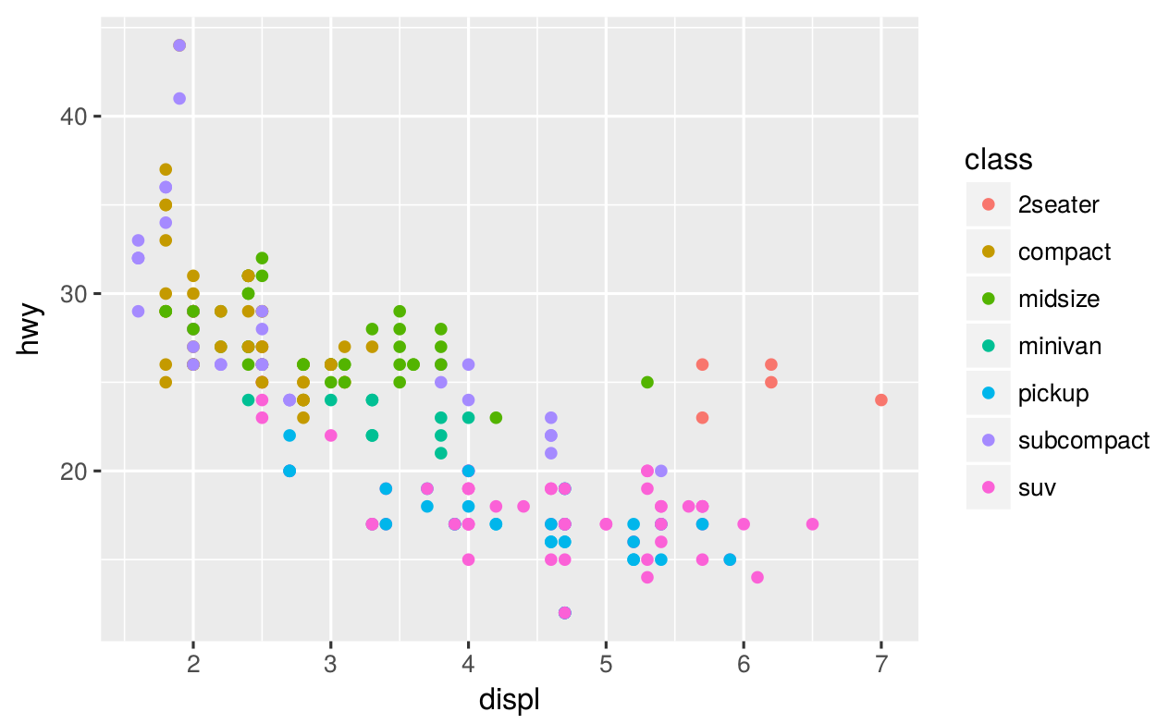
ggplot(data = mpg) + geom_point(mapping = aes(x = displ, y = hwy, color = class))

Slide 24
ggplot(data = mpg) + geom_point(mapping = aes(x = displ, y = hwy, color = class))
Aesthetics:
x-position mapped to engine size
y-position mapped to fuel efficiency
color mapped to car type
Geometric objects: points
Transformation: identity
Scales: continuous, cartesian coordinates
No facets

Slide 25
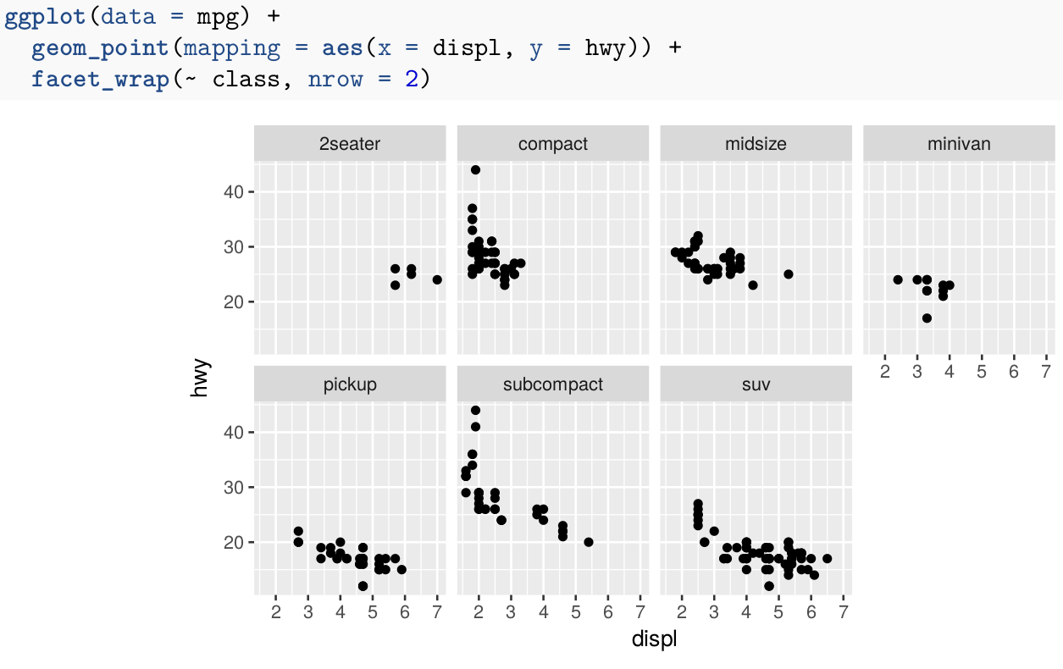
Facets

Slide 26
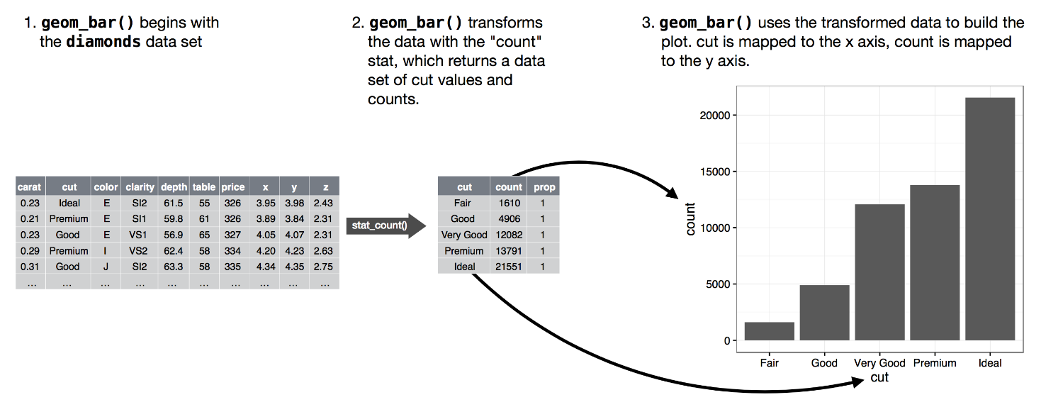
Transformation (stats)

Slide 27
What should I choose?

Slide 28
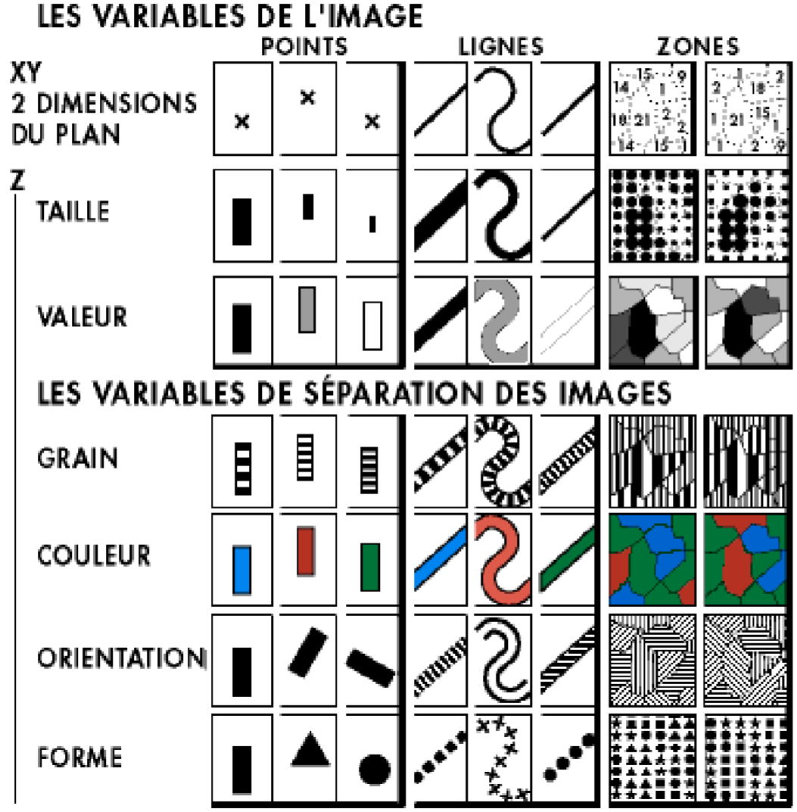

Slide 29
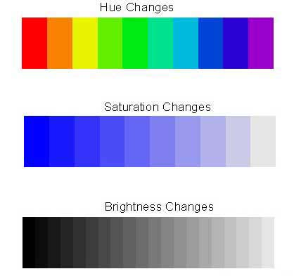
Color: hue-saturation-brightness (HSB)

Slide 30
Mackinlay’s ranking of encodings
Quantitative | Ordinal | Nominal
Position | Position | Position
Length | Density | Color hue
Angle | Color saturation | Texture
Slope | Color Hue | Connection
Area | Texture | Containment
Volume | Connection | Density
Density | Containment | Color saturation
Color saturation | Length | Shape
Color hue | Angle | Length
Texture | Slope | Angle
Connection | Area | Slope
Containment | Volume | Area
Shape | Shape | Volume

Slide 31
Gestalt principles of relatedness
Proximity: Things that are spatially near to one another seem to be related.
Similarity: Things that look alike seem to be related.
Connection: Things that are visually tied to one another seem to be related.
Continuity: Partially hidden objects are completed into familiar shapes.
Closure: Incomplete shapes are perceived as complete.
Figure and ground: Visual elements are taken to be either in the foreground or in the background.
Common fate: Elements sharing a direction of movement are perceived as a unit.

Slide 32
Source: Healy (2019)

Slide 33
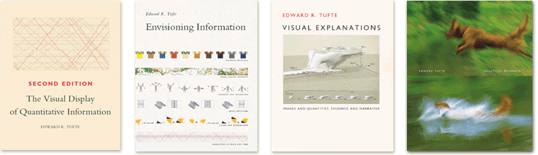
Some (distilled) principles from Tufte
Ask how data maps to perception
Ask which comparisons you want, guide eye to those
Maximize data-to-ink ratio
Present more data (without losing interpretability)
Use levels of detail
(Remember narrative)

Slide 34
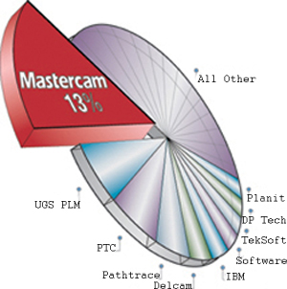

Slide 35
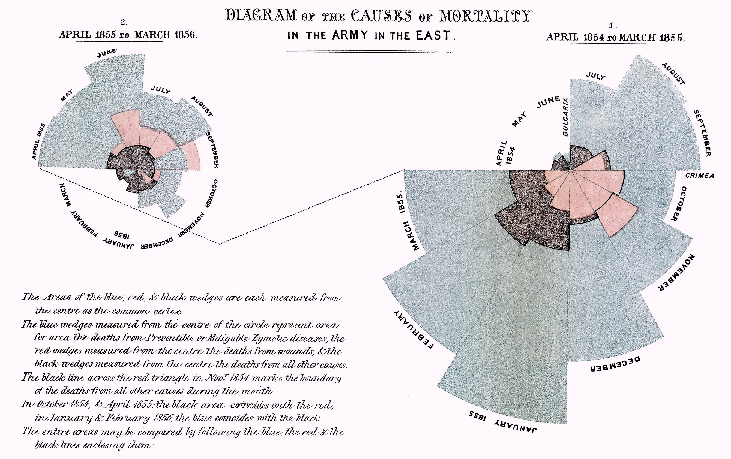
Nightingale Rose / Coxcomb chart

Slide 36
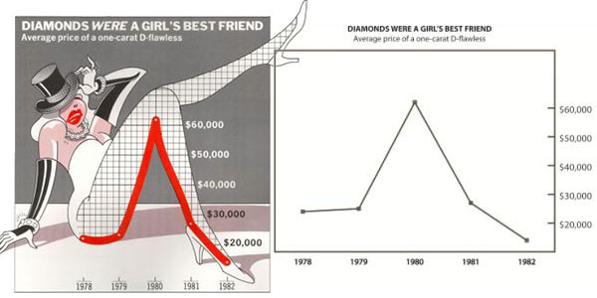

Slide 37
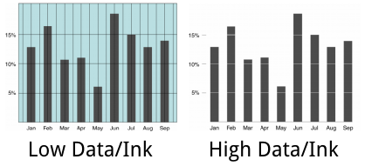

Slide 38
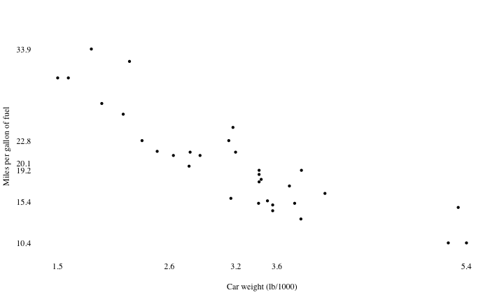

Slide 39
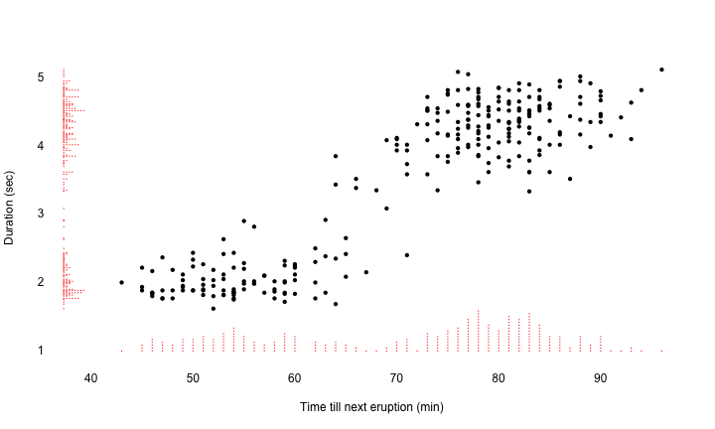

Slide 40
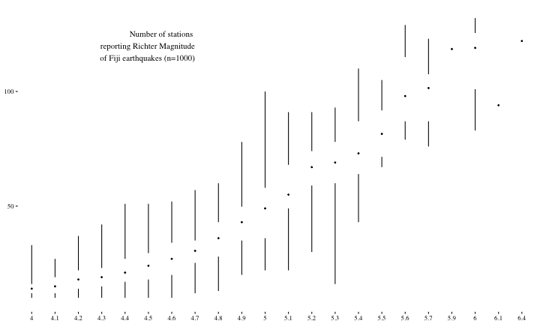
ggplot(quakes, aes(factor(mag), stations)) + theme_tufte() + geom_tufteboxplot(outlier.colour = "transparent") + theme(axis.title = element_blank())

Slide 41
Tufte wisdom
Tufte’s principles are more oriented to communication and can be taken too far
Better data/ink → display more information without overload;
Thinking about perception can help you choose better geoms, aesthetics.

Slide 42
Some practice

Slide 43
Answer these questions:
Are we plotting the right thing?
What are: aesthetics, geom, scale, facets, transformation, coordinate system
How is data/ink?
Is perception considered optimally?
Can you think of questions you can’t answer from this plot which are in the data?

Slide 44
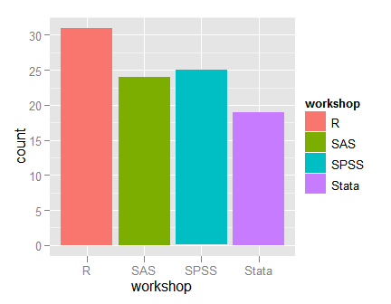

Slide 45
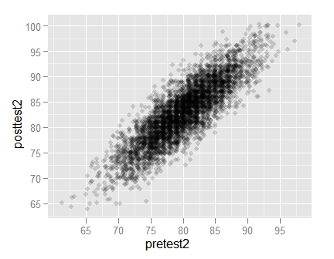

Slide 46
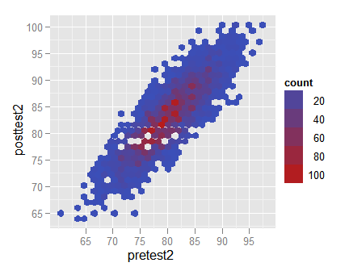

Slide 47
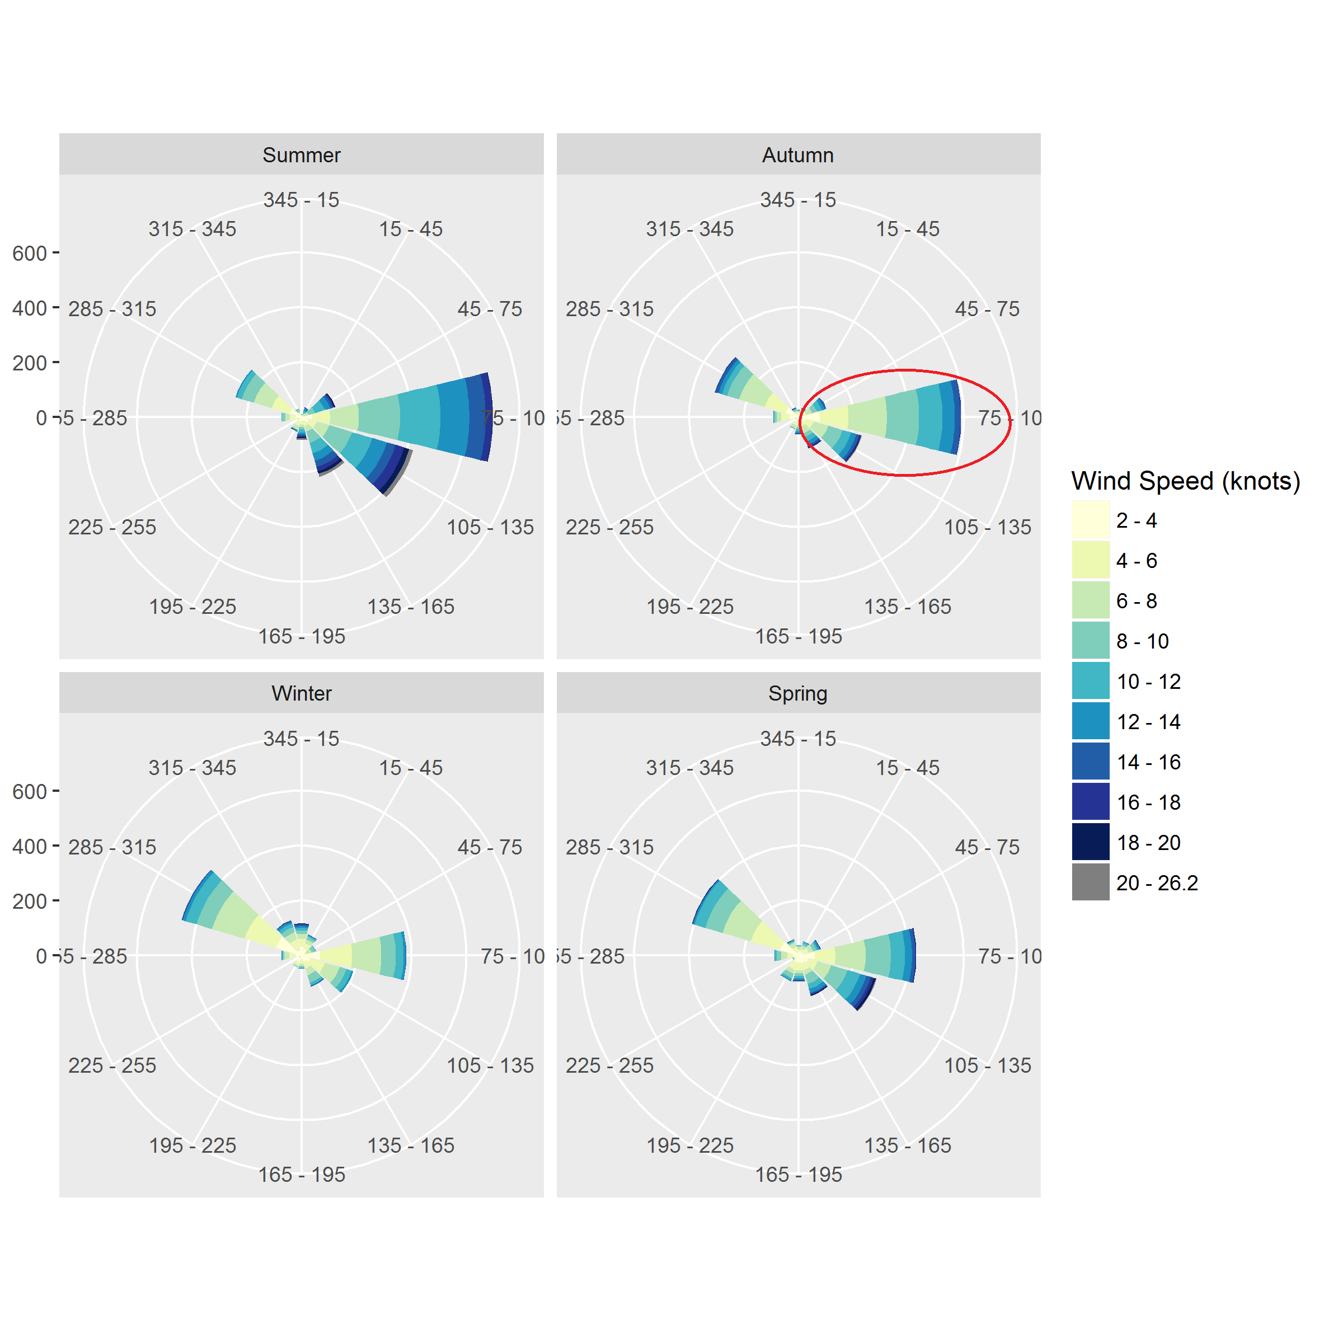

Slide 48
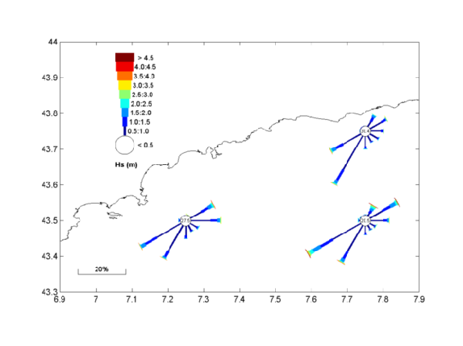

Slide 49
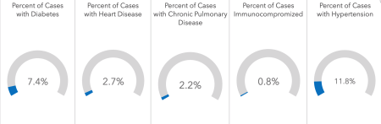
Arkansas COVID-19 dashboard

Slide 50
Conclusion

Slide 51
Conclusion
Data visualization is a huge field;
Sticking to basic principles helps:
Map data to aesthetics, geoms, scales, facets;
Perception research guides choices;
Which comparisons do I want?
Maximize data-ink (within reason).

